Slide 1
Year 6 Residential Trip
Mon 18th – Fri 22nd May 2026
Notes:
ID=d924773e-9a16-4d6d-9803-8cb819e99682
Recipe=text_billboard
Type=TextOnly
Variant=0
FamilyID=AccentBoxWalbaum_Zero

Slide 2
Aims
Developing personal and social skills
Developing independence and confidence
Opportunities for speaking and using French
Supporting learning in History – World War II
Outdoor and adventurous activities

Slide 3
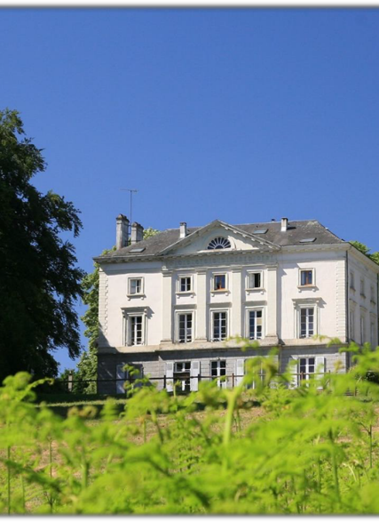
Chateau Beaumont
Family run company with over 18 years of experience with running trips in France & UK
Roxeth Primary School has been coming here since 2008!

Slide 4
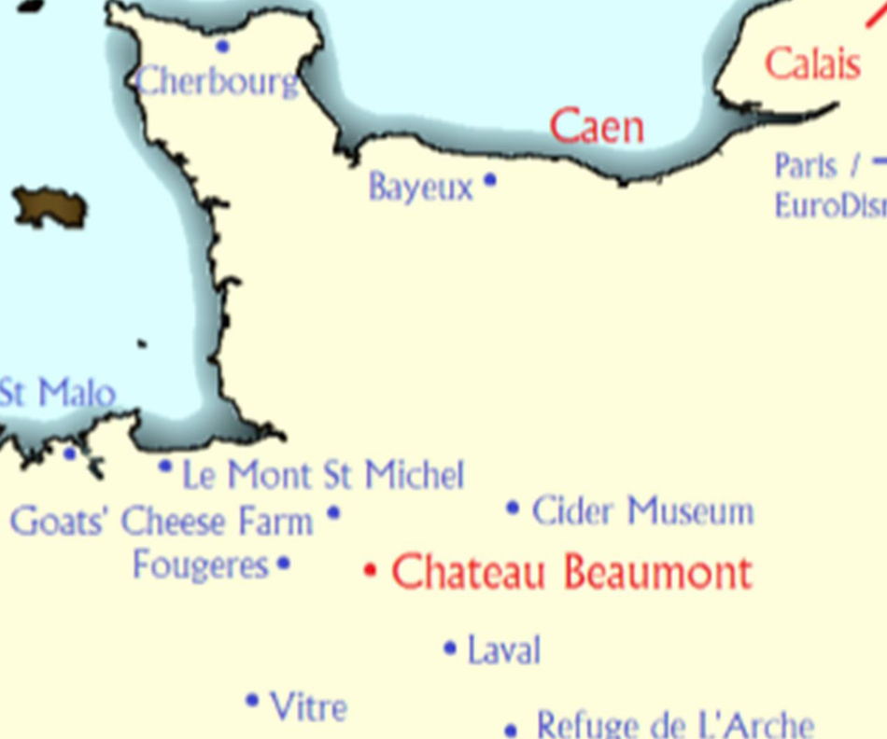
Where are they?
On the borders of Normandy and the Loire Valley. Perfect for immersing students in both French language and the fascinating culture of Normandy.
There are exciting excursions such as Le Mont St Michel & Bayeux close-by.

Slide 5
Travel Arrangements
Outward
Return
Departure on Monday morning at 3am
Journey by coach to Portsmouth – 6 hour crossing
Packed breakfast & lunch
Coach to Chateau Beaumont
Arrive 6pm, unpacking and dinner
Orientation activity
Return via Arromanches WWII excursion
Evening meal on ferry
Coach to school
Arrive back to school at around midnight on Friday

Slide 6
Safety
All activities, site and journey fully risk assessed
All staff are DBS checked (police checked)
All staff risk assessed on site
Group ratios 1 adult to 8 children accompanying children. On site activities 1 adult to maximum 15 children
Night Duty Manager on site

Slide 7
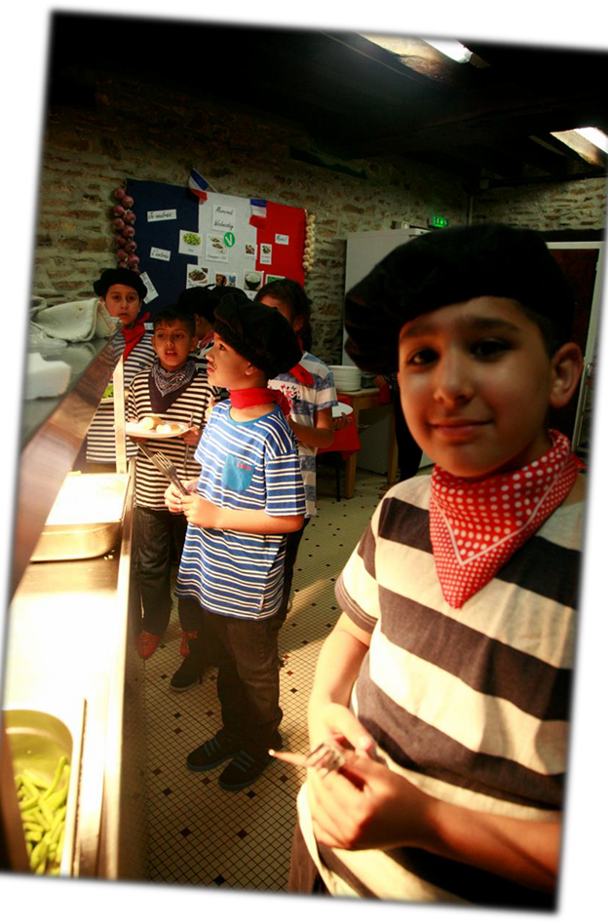
Meals
All dietary requirements catered to
Healthy nutritious and delicious 3 meals a day
French night, where students can try French cuisine in a fun way

Slide 8
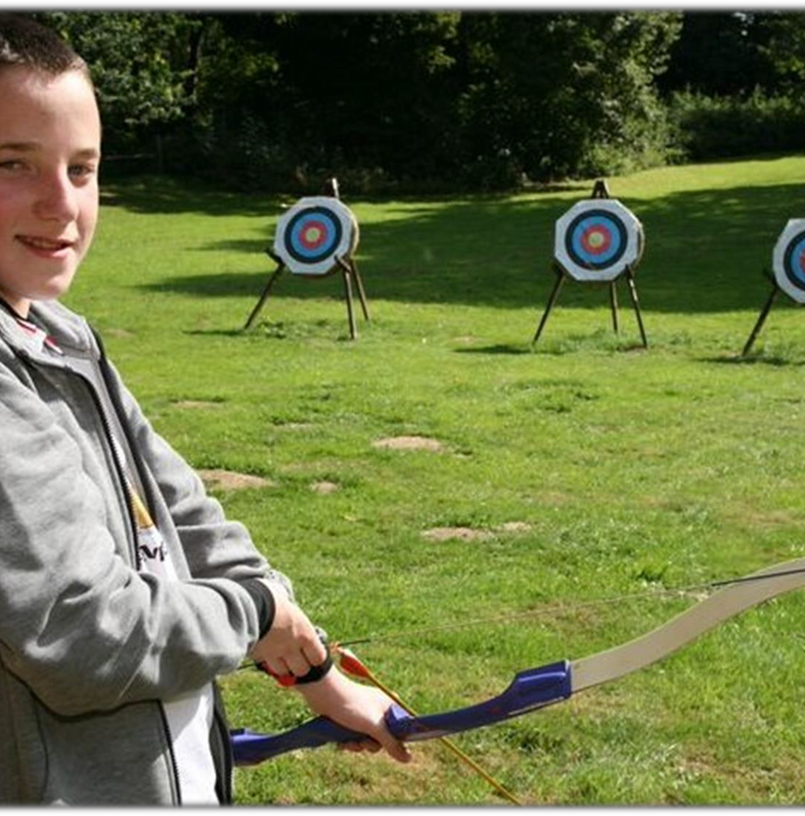
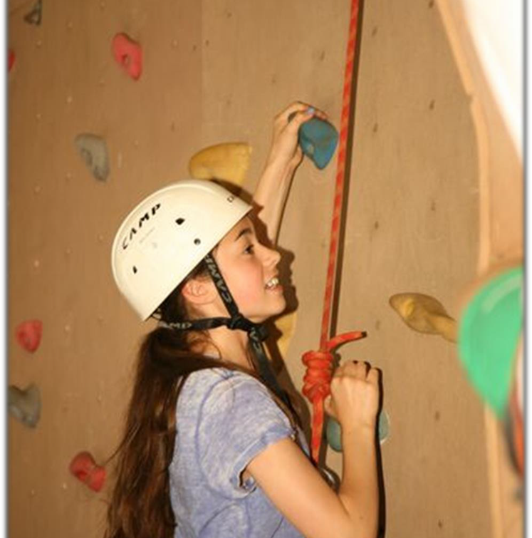
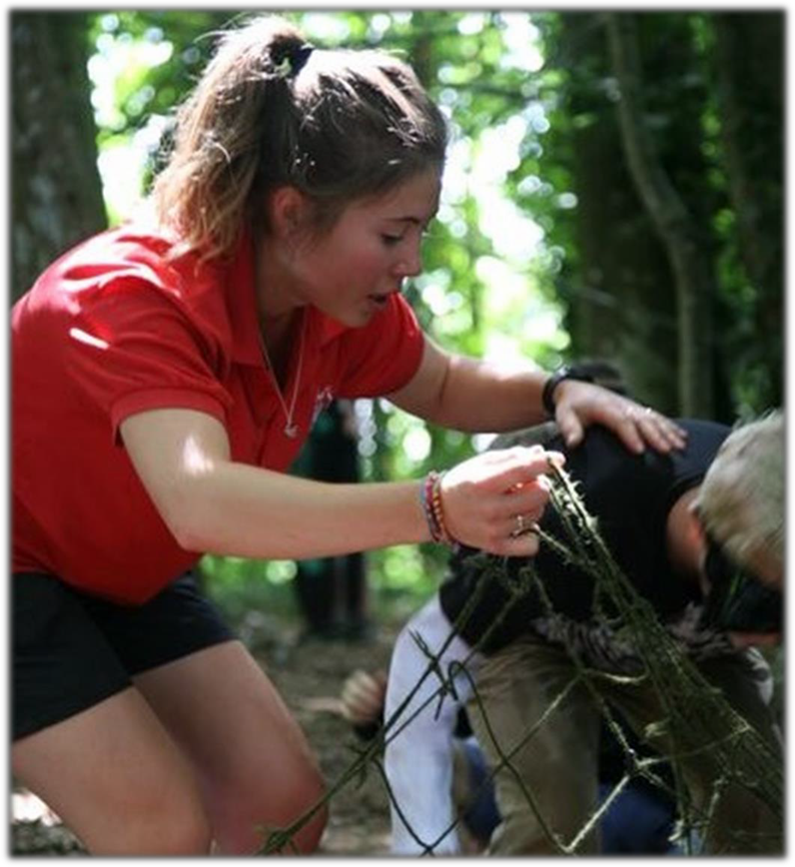
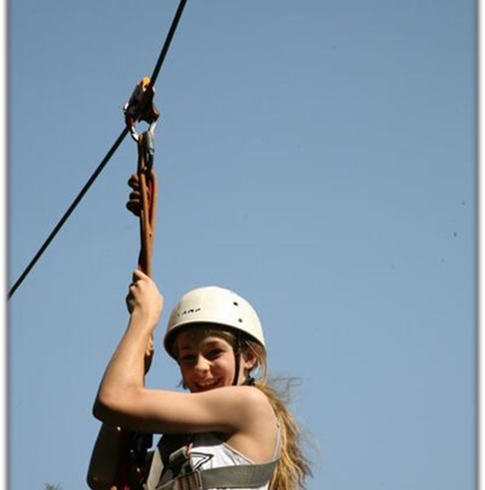
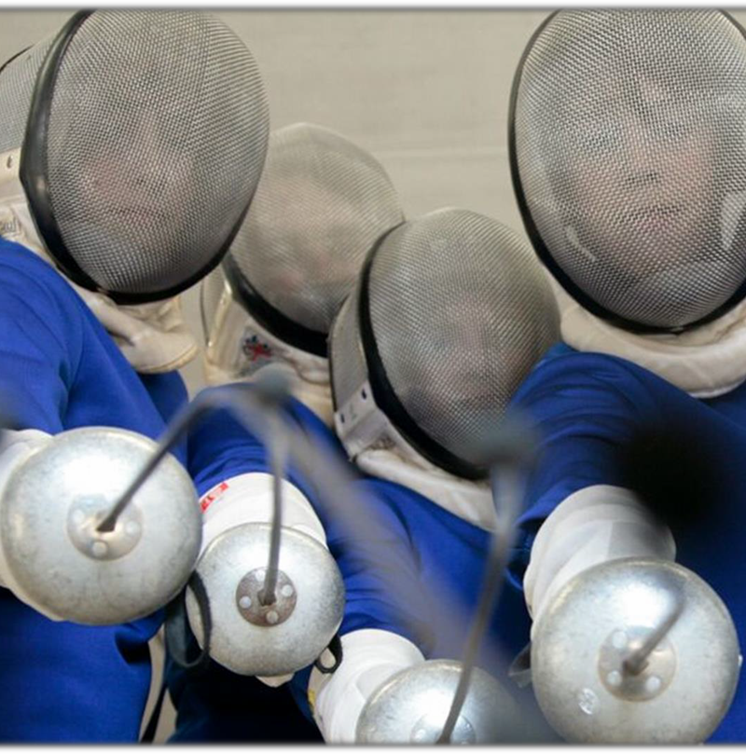
Activities & Excursions
They offer an exciting selection of on-site activities, perfect for students to develop key team work, initiative and French vocabulary skills!
Archery
Climbing wall
Nightline
Zipwire
Fencing
As a fundamental part of the Château Beaumont programme, they offer a great selection of excursions and boast many strong local contacts. All of their excursions immerse students in the real culture, language and heritage of Normandy.

Slide 9
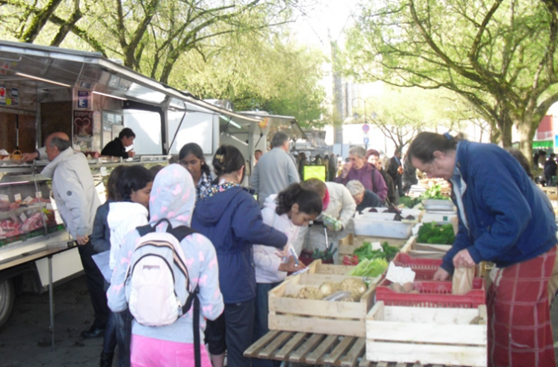
Laval Market

Slide 10
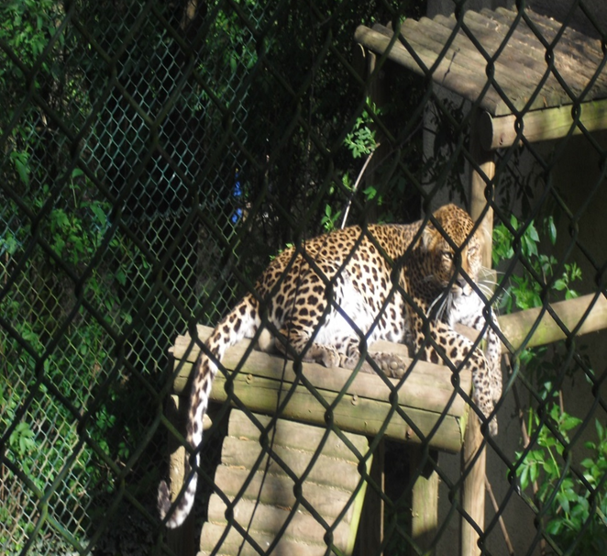
Animal Sanctuary

Slide 11
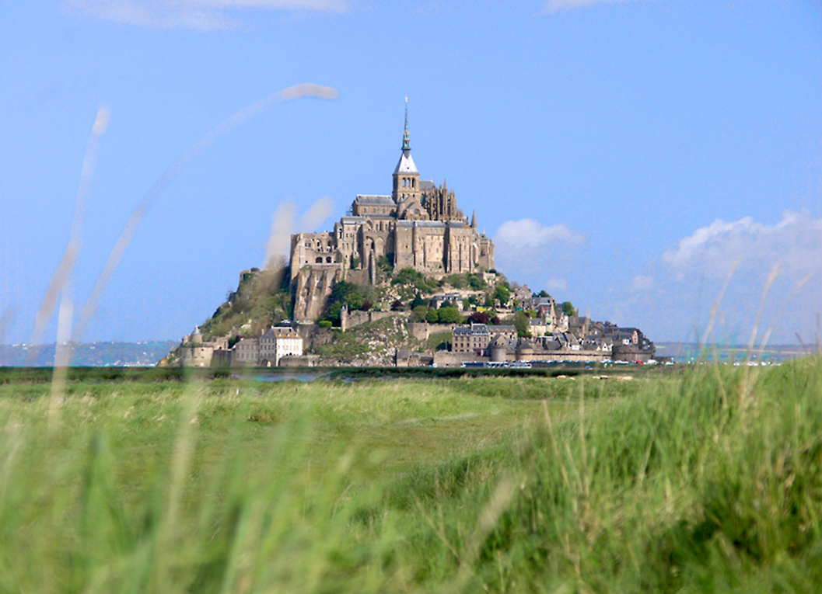
Mont St Michel

Slide 12
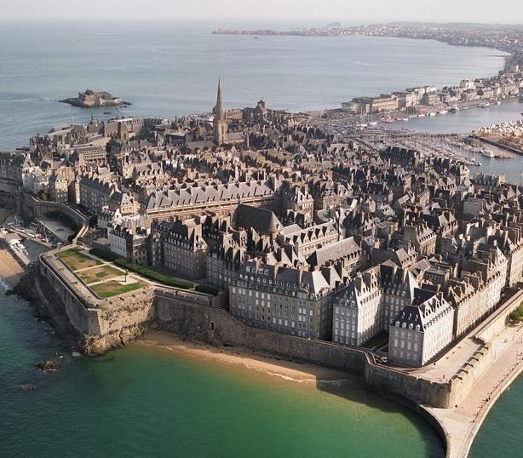
St Malo
Walled City

Slide 13
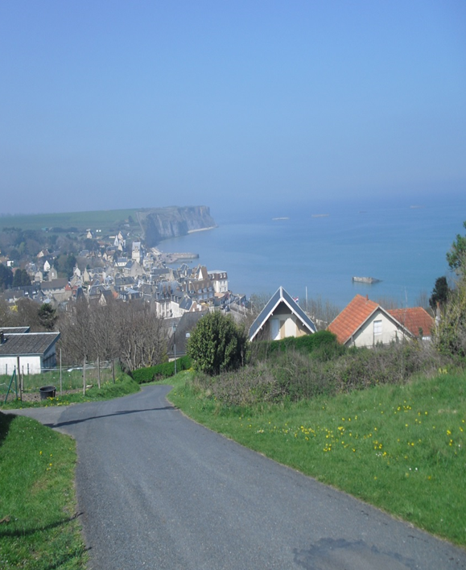
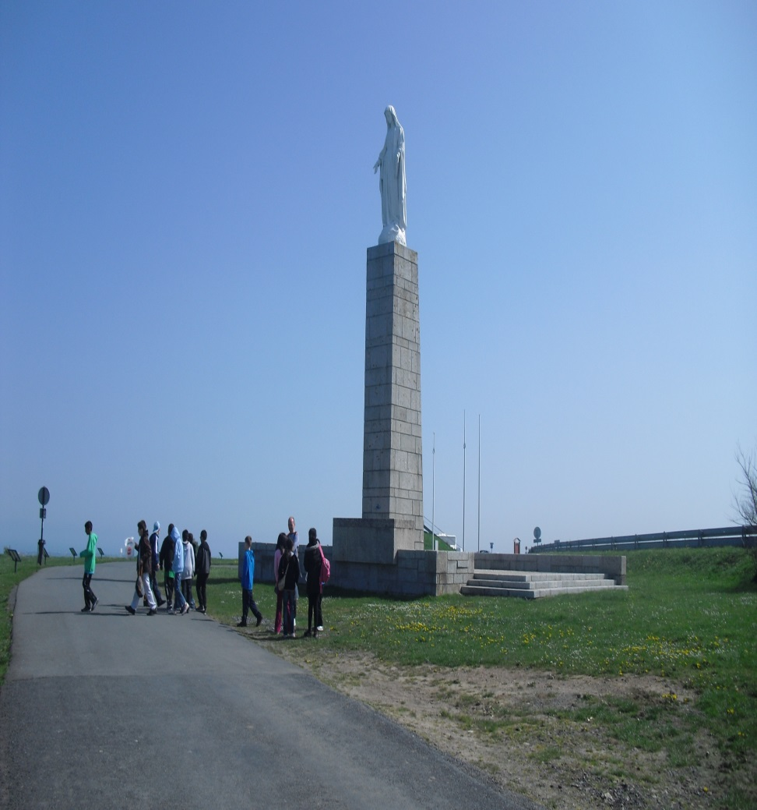
Arromanches
Landing
Beaches

Slide 14
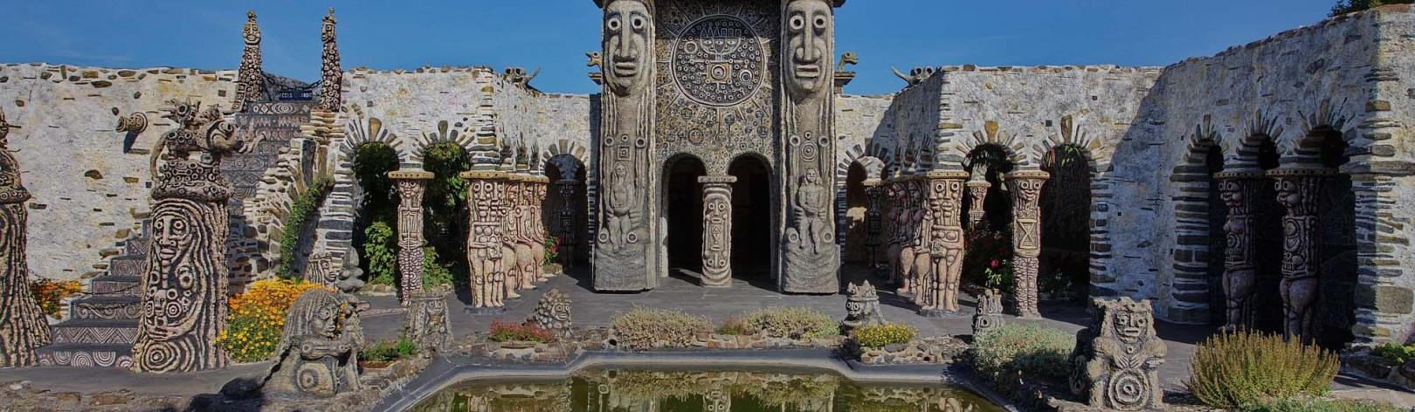
Robert Tatin Sculpture Museum & Gardens

Slide 15
Price
Chateau Beaumont, France
Cost of 5 day visit: £611
Mon 18th – Fri 22nd May 2026
Overseas children need to have a passport; British children to travel with their passport
5 activities and daily historical & cultural excursions

Slide 16
What next?
We need at least 32 children to attend for the trip to be viable
A Google Form will go out very soon where you can register your interest for the trip options.
Once numbers have been confirmed, you will be notified by letter that a trip will be going ahead
Deposit to be paid by end of September (£100) to secure your place and show your commitment
Deposits will not be refunded if you change your mind. Once you have paid the deposit and commit, you are liable to pay the whole fee if you change their mind.
Balance can then be paid in full or regular monthly instalments
If you are interested but require financial support, come to the school office to enquire
Notes:
Once you have paid the deposit and commit, they are liable to pay the whole fee if they change their mind. There are no exceptions. The school cannot make a loss because they have changed their mind. Budgets are for school are extremely tight.

